Slide 1
SICSS-Rutgers 2021
Twitter API Tutorial
Burcu & Luxuan
06/15/2021

Slide 2
Agenda
Collecting Twitter Data
Twitter API (Standard vs. Academic)
How to Apply
Twitter API and R
A short tutorial on using the rtweet package
A short tutorial on using the academictwitteR package
Building queries
Returned objects
Some Useful Links

Slide 3
Collecting Twitter Data
There are a variety of ways to collect Twitter data
Collection Data through Twitter APIs Link
Standard API (Standard Product Track) Link
Academic Research API (Academic Research Product Track) Link
Rehydrating Tweets Link
Scraping Tweets Link

Slide 4
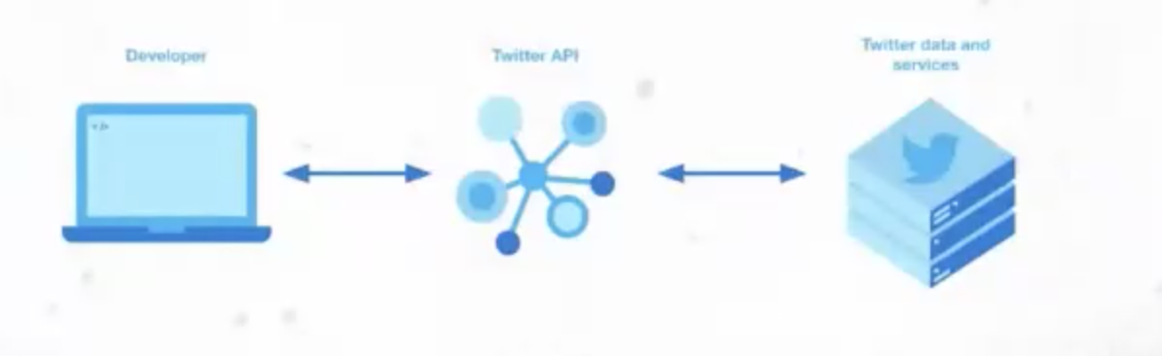
Collecting Twitter Data through Twitter API
Twitter provides researchers access to Twitter data through APIs (Application
Programming Interface).
The Twitter API is a programmatic way to interact with Twitter. It provides developers with the ability to access Twitter data and services.
Source: Twitter
Developer
Twitter API
Twitter data and services

Slide 5
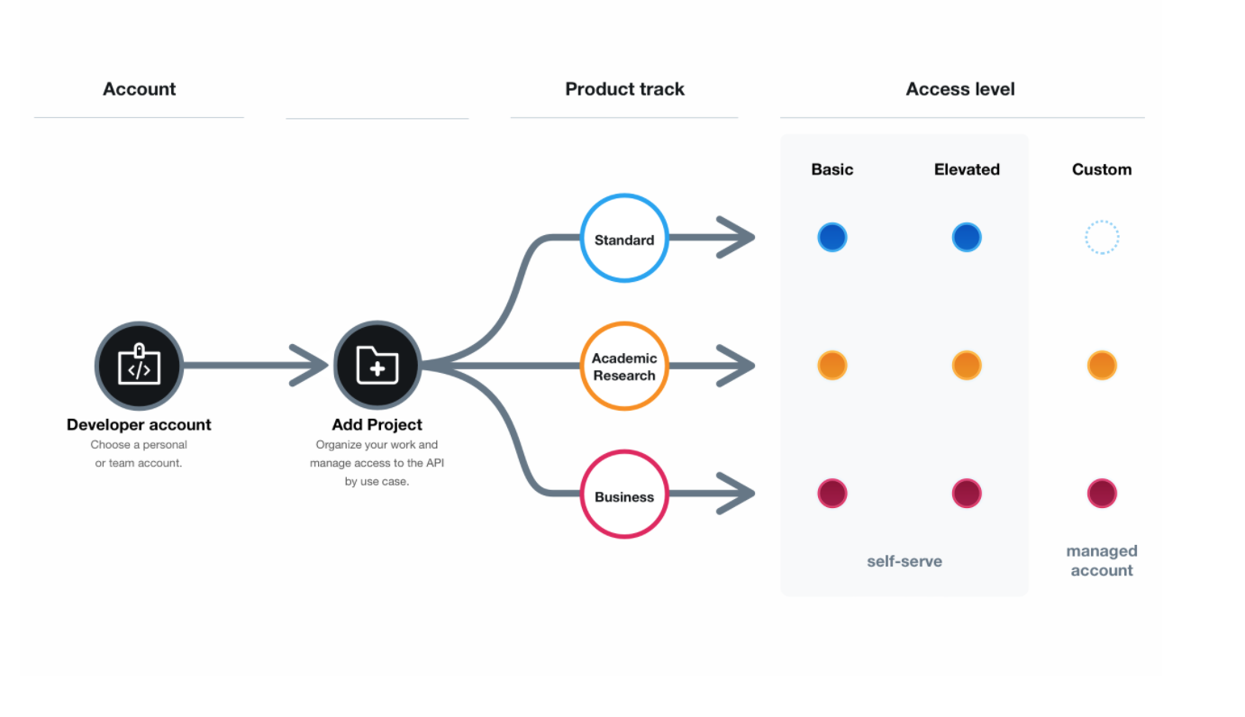
Different Types of Twitter API
Twitter provides distinct APIs to meet the needs of different developers.
Distinct APIs are associated with distinct “product tracks” with different access levels.
Source: Twitter

Slide 6
Standard vs. Academic API
Previously, most researchers have been using the Standard Track (Standard API) if they were not part of paid enterprises or premium customers.
The Academic Research Product Track (Academic API) announced in January, 2021.
Standard vs. Academic API: Main Differences
Standard API can retrieve 7 days worth of tweets, Academic API has free access to the full history of public conservation
Standard API allows to collect 500,000 tweets per month, Academic API allows to collect 10,000,000 tweets per month.
Standard API has limited filtering capabilities, Academic API allows more precise filtering capabilities by supporting additional search operators (e.g. difference in query lengths, concurrent rules)

Slide 7
How to Apply
Prepare a Twitter account (Standard & Academic)
Prepare a webpage of your profile at your home institution for identification (Only for Academic)
Detailed explanation of how you plan to use Twitter data and/or API, methodology for analyzing Twitter data, and how you will present your analysis (aggregated results vs. individual tweets). (Standard & Academic)
Application link: https://developer.twitter.com/en/portal/petition/academic/is-it-right-for-you.
Tips for Twitter developer access: Link
Let’s continue with the application process!

Slide 8
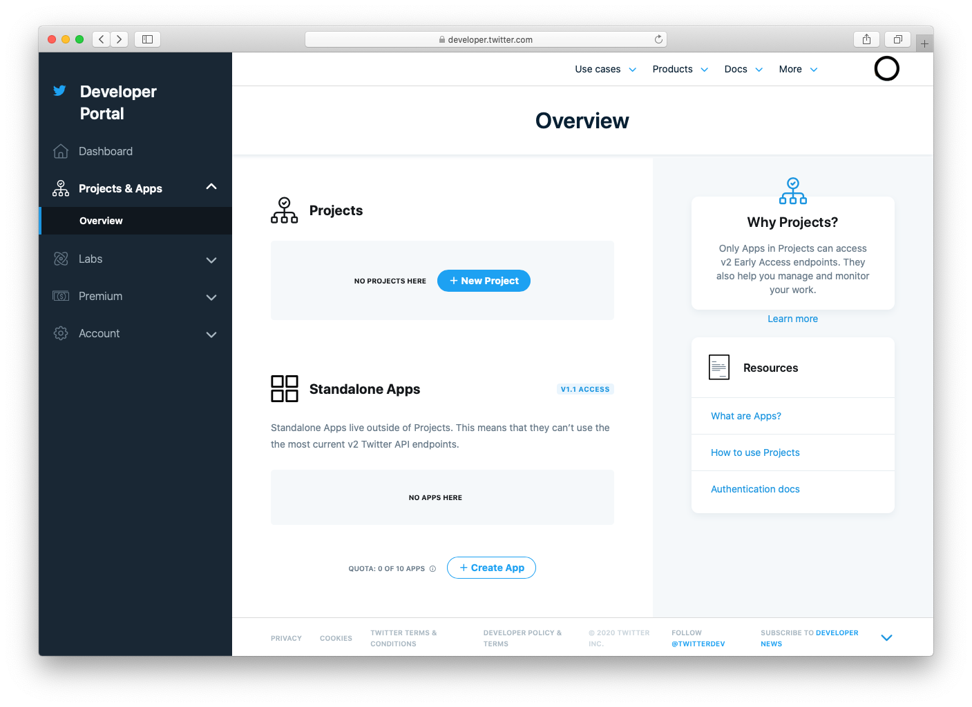
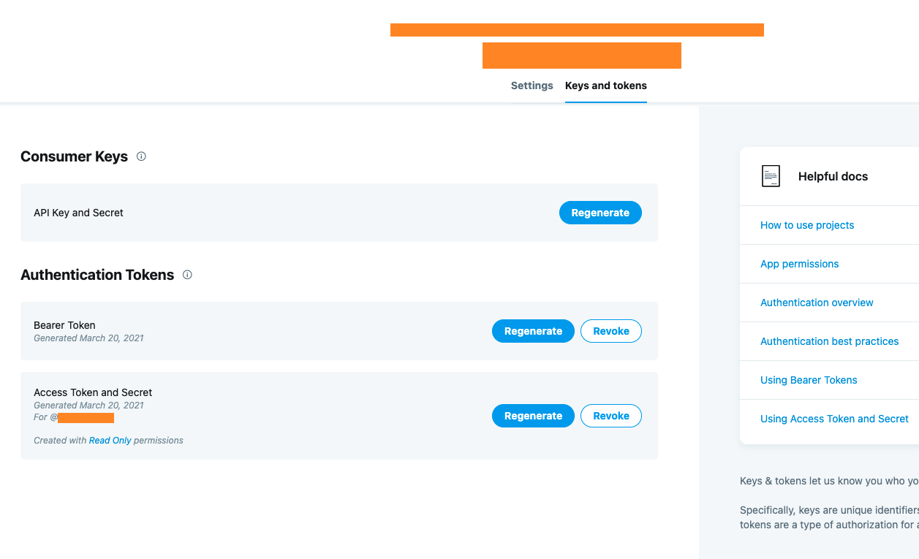
Create a project & Save keys and tokens
Notes:
click on “New Project” in your dashboard or the Projects & Apps page within the developer portal. You’ll only be able to see this option if you haven’t already created a Project. You will be prompted to create a Project name, description, and use case. You will also be asked to create a new App or connect an existing standalone App.
If you are approved for the Academic Research product track, your Projects & Apps page will show the Academic Research Project and its details that you submitted with your application.
If your Project doesn’t include an App, you can add one by clicking on the Project name in the dashboard. From there, you can either create a new App or select an existing standalone App to connect to your Project. The App is where you can generate your authentication keys and tokens, including the API Key and API Secret, Access Token and Access Token Secret, and Bearer Token.

Slide 9


Twitter API and R
We can use programming languages such as R to communicate with Twitter API
For Standard API
rtweet package
For Academic API
Existing packages such as rtweet is not built for Academic API.
AcademictwitteR package
Let’s continue with some sample code!

Slide 10
API Documentations
Standard API
Build queries Link
Returned objects Link
Academic API
Build queries Link
Returned objects Link

Slide 11
Some Useful Links
rtweet tutorial Link
academicTwitterR demos Link ; Link
The Twitter developers’ forum Link
This subsection is particularly for academic research and you can find many useful discussions.
Tutorials, articles, and code samples of using academic API by Twitter Link
Python libraries for data collection.
searchtweets library Link
Please feel free to reach out to us when you have any questions! Thank you!

